Slide 2

Angular Component

Slide 3
Angular – Component lifecycle hooks
When the angular application starts it creates and renders the root component. It then creates and renders its Children. For each loaded component, it checks when its data bound properties change and updates them. It destroys the component and removes it from the DOM when no longer in use.
The Angular life cycle hooks are callback function, which angular invokes when a certain event occurs during the component’s life cycle.
For example
When component is initialized, Angular invokes ngOnInit
When a component’s input properties change, Angular invokes ngOnChanges
When a component is destroyed, Angular invokes ngOnDestroy

Slide 4
Angular – Lifecycle hooks
Here is the complete list of life cycle hooks provided by the Angular
ngOnchanges- It is called when a bound input property change.
ngOnInit- It is called once the component is initialized.
ngDocheck – it is called on every change detection runs
ngAfterContentInit- it is called when external content is projected into the component’s view.
ngAfterContentChecked- It is called whenever projected content has been checked
ngAfterviewInit- It is called after component view/child view is initialized
ngAfterViewChecked- it is called whenever view /child view is checked
ngOnDestroy- Called just before Angular destroys the directive/component and is a very good place to clean up resources.

Slide 5
Angular – Component Interaction
Parent Component
@Input Parameter
Child Component
@Output Parameter

Slide 6
Angular – Component Interaction
Pass data to a child component
In Angular, the Parent Component can communicate with the child component by setting its Property. To do that the Child component must expose its properties to the parent component. The Child Component does this by using the @Input decorator.
In the Child Component
Import the @Input module from @angular/Core Library
Mark those property, which need data from parent as input property using @Input decorator
In the Parent Component
Bind the Child component property in the Parent Component when instantiating the Child

Slide 7
Angular – @Input Decorator
@Input Decorator
@Input is a decorator to mark a property as an input. @Input is used to define an input property, to achieve component property binding. @Input decorator is used to pass data (property binding) from parent to child component. The component property should be annotated with @Input decorator to act as input property.

Slide 8
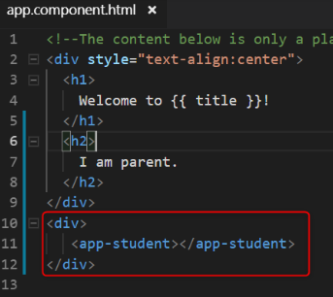
Angular – @Input Decorator
Let's create an angular application. We have created two components. They are app components and student components. We will transfer the data from parent to child component, using @Input decorator. Let’s assume, app-component is the parent component and student-component is the child component.
To make the parent-child relation, keep the instance (selector of student component) of student component inside the template URL (app.component.html) of app component.
In the image, the selected area is the child component.

Slide 9
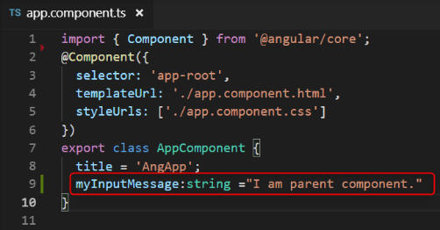
Angular – @Input Decorator
Now, we want to send the message from parent to child component.
Let's open the parent components .ts file (app.component.ts) and declare a variable inside AppComponent class, to store the message. This message is received by the child component.

Slide 10
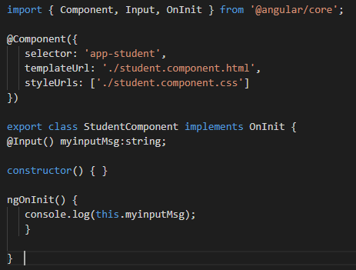
Angular – @Input Decorator
In the image, we have declared a variable( myInputMessage).
Now, let's open parent component views (app.component.html) pass this variable inside child component instance, which is passed inside parent component.

Slide 11
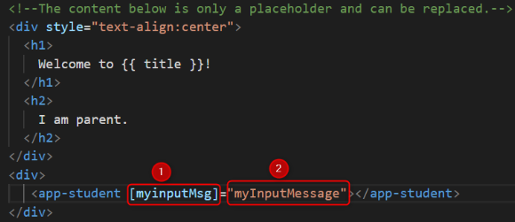
Angular – @Input Decorator
Denotes those variables which will be used by child component (student component) with @Input decorator to fetch the message from parent component and,
denotes those variables which are passed the parent component message to child component.

Slide 12
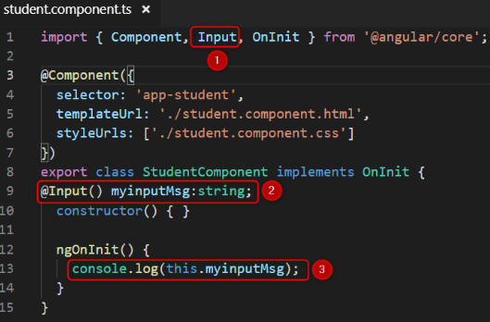
Angular – @Input Decorator
Now, open the child components .ts file (student.component.ts) and import Input decorator, using the myinputMsg variable with @Input decorator and print it inside constructor or ngOnInit().
First import the Input decorator, which is provided by angular and full path is @anuglar/core.
Use @Input decorator and declare those variables which are passed by parent component Html(app.component.html) file's point 1. When we declare those variable (myinputMsg) with @Input decorator it automatically fetches the value of the parent component variable with the help of @Input decorator.
Print the values of this variable inside constructor or ngOnInit(). We have used inside ngOnInit().

Slide 13
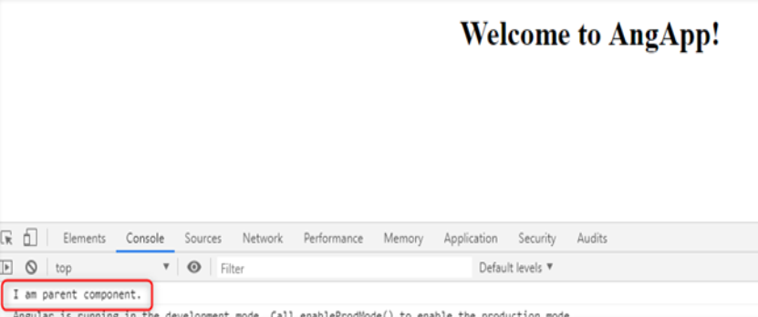
Angular – @Input Decorator
Output:

Slide 14
Angular – @Output Decorator
@Output decorator is used to pass the data from child to parent component. @Output decorator binds a property of a component, to send data from one component to the calling component. @Output binds a property of the type of angular EventEmitter class.
To transfer the data from child to parent component, we use @Output decorator.
Let's Open the child component' .ts file (student.component.ts).
For use the @Output decorator we have to import, two important decorators, they are Output and EventEmitter.

Slide 15
Angular – @Output Decorator
EventEmitter
Use in components with the @Output directive to emit custom events synchronously or asynchronously and register handlers for those events by subscribing to an instance.
Now, create any variable with @Output decorator.
Here in the place of string, we can pass different types of DataTypes.
After that create a variable to store and pass the message to the parent component.

Slide 16
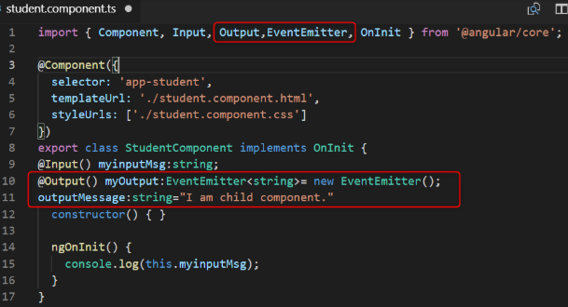
Angular – @Output Decorator
Send the value of output message, to the parent component. Then we create a button and click on this button. We will send the values to the parent component.

Slide 17
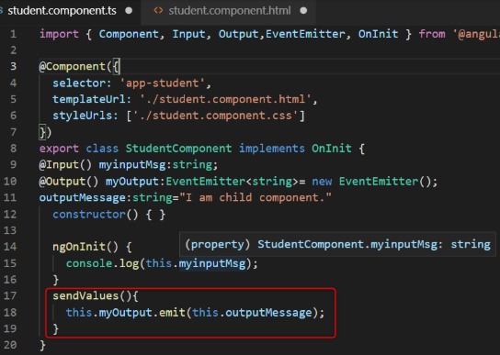
Angular – @Output Decorator
Let's open the child component Html page and create a button and click event of this button. We then send the values.
student.component.html
Now fire the click on student.component.ts.

Slide 18
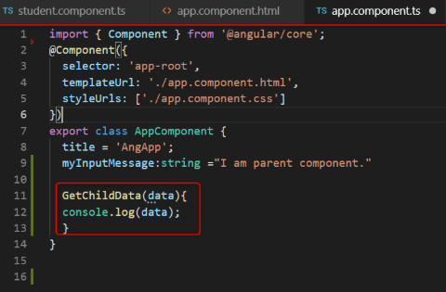
Angular – @Output Decorator
Now, to fetch the value we have to go app.component.html file and use the below code.
function which is GetChildData() on parent component' .ts file, for fetch the data from child component.

Slide 19
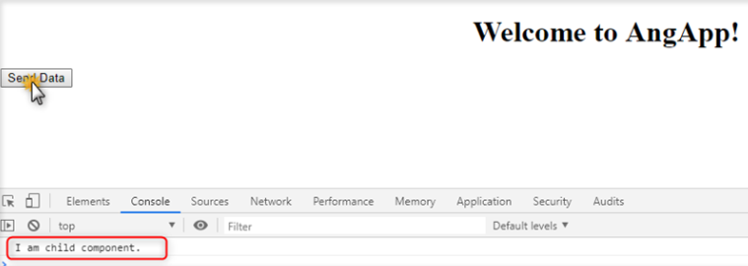
Angular – @Output Decorator
Output

Slide 20
Angular – ViewEncapsulation
View encapsulation defines whether the template and styles defined within the component can affect the whole application or vice versa.
Angular provides three encapsulation strategies:
*None - There is no shadow DOM. Style is not scoped to the component.
*Emulated - Angular will not create a Shadow DOM for the component. Style will be scoped to the component. This is the default value for encapsulation.
*ShadowDom - Angular will create Shadow DOM for the component. Style is scoped to the component.

Slide 21
Angular – Data Binding
Data binding is the core concept of Angular and used to define the communication between a component and the DOM. It is a data binding is a communication between typescript code of component and template which user sees. It makes easy to define interactive applications without worrying about pushing and pulling data.

Slide 22
Angular – Data Binding
One-way databinding
In one-way databinding, the value of the Model is used in the View (HTML page) but we can't update Model from the View. Angular Interpolation / String Interpolation, Property Binding, and Event Binding are the example of one-way databinding.
Two-way databinding
In two-way databinding, automatic synchronization of data happens between the Model and the View. Here, change is reflected in both components. Whenever you make changes in the Model, it will be reflected in the View and when you make changes in View, it will be reflected in Model.
This happens immediately and automatically, ensures that the HTML template and the TypeScript code are updated at all times.
Output Data
TypeScript Code
HTML Template
User Interaction

Slide 23
Angular – Data Binding
Angular provides four types of data binding and they are different on the way of data flowing.
String Interpolation
Property Binding
Event Binding
Two-way binding

Slide 24
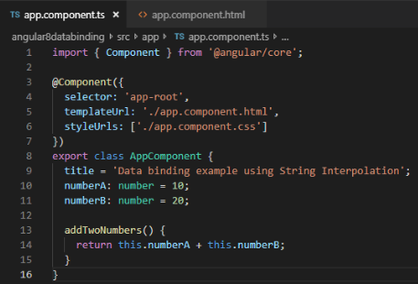
Angular – String Interpolation
String Interpolation is a one-way databinding technique which is used to output the data from a TypeScript code to HTML template (view). It uses the template expression in double curly braces to display the data from the component to the view. String interpolation adds the value of a property from the component.
Example {{ data }}
Open app.component.ts file and use the following code within the file:

Slide 25

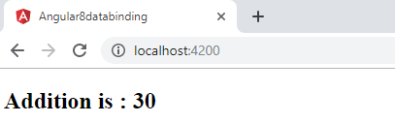
Angular – String Interpolation
Now, open app.component.html and use the following code to see string interpolation.
Now, open command prompt and run the ng serve command to see the result.

Slide 26
Angular – Property Binding
Property Binding is also a one-way data binding technique. In property binding, we bind a property of a DOM element to a field which is a defined property in our component TypeScript code. Actually Angular internally converts string interpolation into property binding.
For example:
<img [src]="imgUrl" />
Property binding is preferred over string interpolation because it has shorter and cleaner code String interpolation should be used when you want to simply display some dynamic data from a component on the view between headings like h1, h2, p etc.

Slide 27
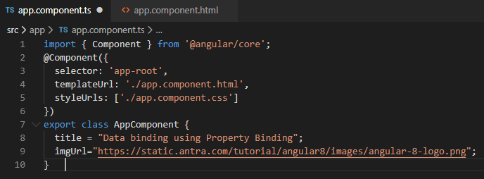
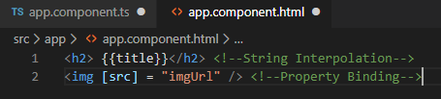
Angular – Property Binding
Open app.componnt.ts file and add the following code:
Now, open app.component.html and use the following code for property binding:

Slide 28
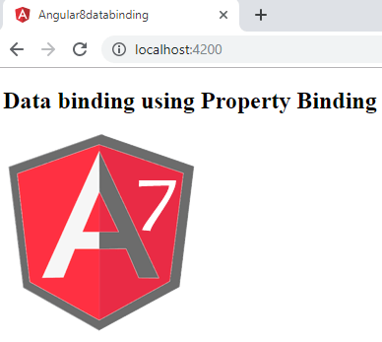
Angular – Property Binding
Run the ng serve command and open local host to see the result.

Slide 29
Angular – Event Binding
In Angular, event binding is used to handle the events raised from the DOM like button click, mouse move etc. When the DOM event happens (eg. click, change, keyup), it calls the specified method in the component. In the following example, the cookBacon() method from the component is called when the button is clicked:
Example:

Slide 30
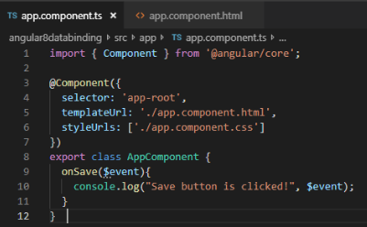
Angular – Event Binding
Example
Let's take a button in the HTML template and handle the click event of this button. To implement event binding, we will bind click event of a button with a method of the component.
Now, open the app.component.ts file and use the following code:

Slide 31

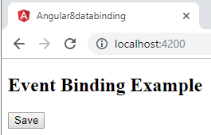
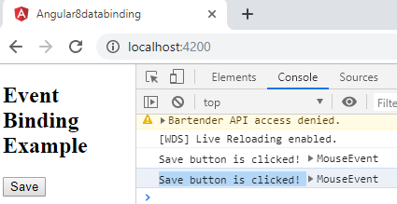
Angular – Event Binding
app.component .html
Output:
Click on the "Save" button and open console to see result.

Slide 32
Angular – Two-way Data binding
In two-way databinding, automatic synchronization of data happens between the Model and the View. Here, change is reflected in both components. Whenever you make changes in the Model, it will be reflected in the View and when you make changes in View, it will be reflected in Model.
This happens immediately and automatically, ensures that the HTML template and the TypeScript code are updated at all times.
In two-way data binding, property binding and event binding are combined together.
Syntax: [(ngModel)] = "[property of your component]"

Slide 33
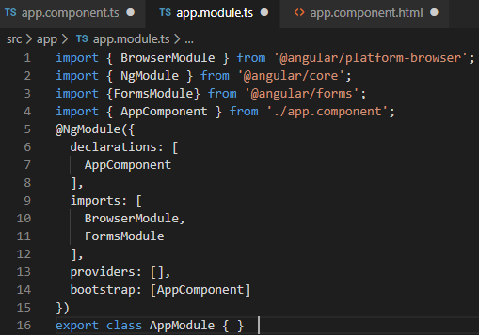
Angular – Two-way data binding
Example: Open the app.module.ts file

Slide 34
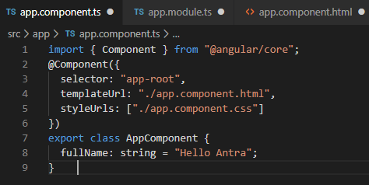
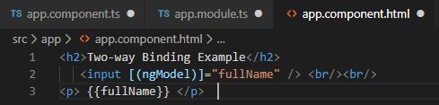
Angular – Two-way data binding
app.component.ts file:
app.component .html:

Slide 35
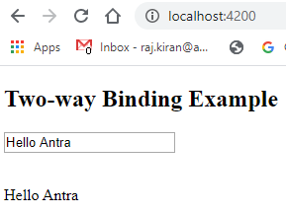
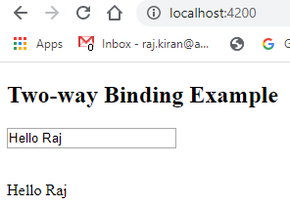
Angular – Two-way data binding
Now, start server and open local host browser to see the result.
Here, we can see that changing textbox values update property value in component.
Fetched value from component.

Slide 36
Thank You

